Slide 1
Shareholders Rights Directive II SMPG Task Force Progress Status
Jacques Littré, SWIFT Standards
SMPG General secretary
January 2019

Slide 2
SRD II - Timeline Level 1
1. SRD II & Implementing Regulation
2017 |  |  |  |  |  |  |  |  |  |  |  | 2018 |  |  |  |  |  |  |  |  |  |  |  | 2019 |  |  |  |  |  |  |  |  |  |  |  | 2020
Q1 |  |  | Q2 |  |  | Q3 |  |  | Q4 |  |  | Q1 |  |  | Q2 |  |  | Q3 |  |  | Q4 |  |  | Q1 |  |  | Q2 |  |  | Q3 |  |  | Q4 |  |  | Q1 |  |  | Q2 |  |  | Q3 |  |  | Q4
J | F | M | A | M | J | J | A | S | O | N | D | J | F | M | A | M | J | J | A | S | O | N | D | J | F | M | A | M | J | J | A | S | O | N | D | J | F | M | A | M | J | J | A | S | O | N | D
Transposition Time
10 June 2017
10 June 2019 (Transposition limit)
SRD II - Timeline Level 2 – Implementing Regulation
2017 |  |  |  |  |  |  |  |  |  |  |  | 2018 |  |  |  |  |  |  |  |  |  |  |  | 2019 |  |  |  |  |  |  |  |  |  |  |  | 2020
Q1 |  |  | Q2 |  |  | Q3 |  |  | Q4 |  |  | Q1 |  |  | Q2 |  |  | Q3 |  |  | Q4 |  |  | Q1 |  |  | Q2 |  |  | Q3 |  |  | Q4 |  |  | Q1 |  |  | Q2 |  |  | Q3 |  |  | Q4
J | F | M | A | M | J | J | A | S | O | N | D | J | F | M | A | M | J | J | A | S | O | N | D | J | F | M | A | M | J | J | A | S | O | N | D | J | F | M | A | M | J | J | A | S | O | N | D
Time to adopt the Level 2 Measures
Legend:
Entry into Force
3 September 2018
3 September 2020
2
Application

Slide 3
2. SMPG / SWIFT - Driving the Messaging Solution
August 2018:
The SMPG SC approves the CA WG proposal to contact the DG Justice and propose them to drive the ISO 20022 messaging solution for SRD2 for the community via a SRD2 Expert Task Force.
September 28, 2018:
An SMPG SC’s delegation met with the DG Justice. The DG Justice welcomes the initiative to develop new ISO 20022 messages and maintain the PV and CA Solutions.
October 2018:
The SMPG launched a call for TF members via the NMPG’s representatives.
Task Force Objectives
Gap Analysis between the IR and the existing CA & PV messages
Identify new Flows
Submit an ISO 20022 Business Justification to ISO RA for new messages
Submit change requests for SR2020 for existing CA & PV messages
November 20, 2018:
SRD2 TF Expert group Kick-Off meeting at SWIFT
November 29 – December 18, 2018:
4 conference calls held – Analysis of the IR minimum requirements Completed
End December - January 2019
Prepare and Submit ISO 20022 Business Justification (BJ) to ISO 20022 RA
January 7, 2019 - Requirements Analysis and Message Mapping Documents and Draft BJ sent for Review to SMPG (Link to SMPG Web site)

Slide 4
3. Shareholders Identification Message Flow (2)
Shareholder Identification Request / Response
Issuer
Request
Response
Request
Issuer / Issuer Agent / CSD / Third Party
Response
Response
Response
Response
Intermediary A
Intermediary B
Intermediary C
Intermediary D
Shareholder
Request
Request
Request
Request: Going Down the chain of Intermediaries
Response: Going from Intermediary directly to Issuer / Agent / Third Party

Slide 5
4. Implementing Regulation & ISO Messaging Impact
Art. 1: Definitions (Issuer, Issuer CSD, Intermediary, Last Intermediary,...)
Art. 2: Standardised formats, interoperability and language (ISO standards, Tools and facilities for non shareholders,…)
Art. 3: Request to disclose information regarding shareholder identity and response
Annex Requirements Table 1 & 2 -> New Flow, new ISO 20022 Messages
Art. 4: Transmission of meeting notice
Annex Requirements Table 3 -> Impact on PV “Meeting Notification” Message
Art. 5: Confirmation of entitlement to exercise shareholders rights in a GM
Annex Requirements Table 4 -> Impact on “Meeting Entitlement” Notification
Art. 6: Notice of participation by shareholder in a general meeting
Annex Requirements Table 5 - > Impact on “Meeting Instruction“ message
Art. 7: Format of confirmation of the receipt and recording and counting of votes
Annex Requirements Table 6 & 7 -> Impact on “Meeting Instruction Status” and “Meeting Vote Execution Conf.” messages
Art. 8: Transmission of information specific to corporate events (other than GMs)
Annex Requirements Table 8 -> No Amendments to Announcement message
Art. 9: Deadlines for issuers and intermediaries in CA events and in shareholder identification processes (Transmission without delay,…) -> No Standard Messaging Impact
Art. 10: Minimum security requirements (Security, Integrity, Authentication of the information,…) -> No Standard messaging Impact (TBD) ?

Slide 6
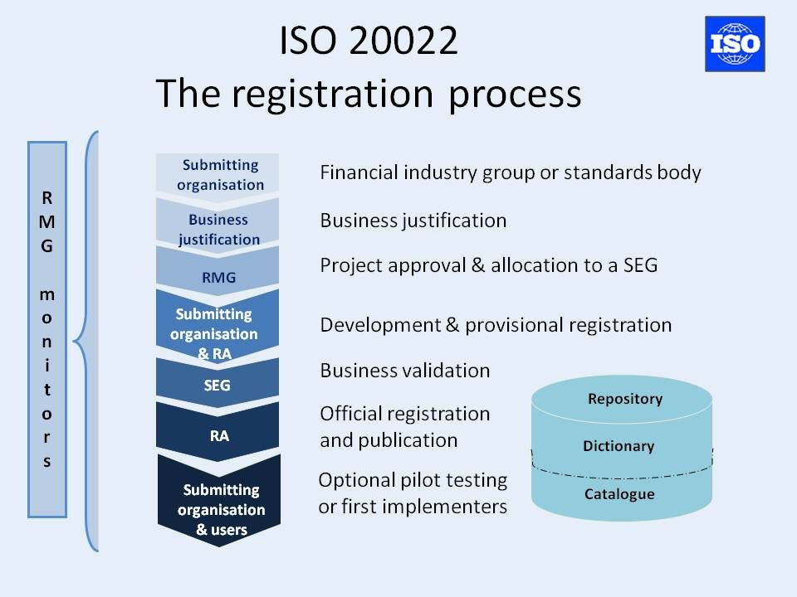
8. ISO 20022 Development Timeline New messages
ISO 20022 PROCESS
Oct. 2019
May 2020
Business Justification (BJ)
Publication
of ISO 20022
Messaging
Standards
Activation
On SWIFT
Network
BJ Approval by SEG
& form the ISO SEG ET
Message Development & Registration
Business Validation
Users Implementation period
Registration and Publication
2018
2019
2020
Sept. 2018
Sept. 2020
SRD2 IR Publication
Deadline for implementation
of Shareholder Identif. + Voting
+ Transmission of Info

Slide 7
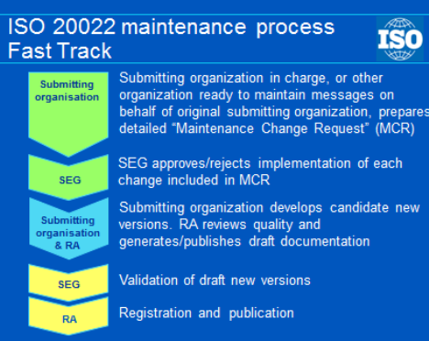
10. ISO 20022 PV Messages Maintenance Timeline
Use the ISO Fast Track Maintenance Process
ISO 20022 PROCESS
Oct. 2019
May 2020
Publication
of ISO 20022
Messaging
Standards
Activation
On SWIFT
Network
PV MCR (Maintenance Change Request )
Preparation
SEG Approves MCR
Message Development
Users Implementation period
SEG Message Validation & Approval
Registration and Publication
2018
2019
2020
Sept. 2018
Sept. 2020
SRD2 IR Publication
Deadline for implementation
of Shareholder Identif. + Voting
+ Transmission of Info

Slide 8
9. ISO 20022 CA Messages Maintenance Timeline
ISO 20022 PROCESS
ISO 20022 Process for ISO 15022/20022 Coexistent Standards
CA & PV Change Request Preparation
Feb. 2020
Nov. 2020
June 1st
Change Request Deadline
Publication
of ISO 20022
Messaging
Standards
Activation
On SWIFT
Network
CRs Impact Analysis and Design
CA MWG review Period
MWG Meeting
August 23rd
Users Implementation period
Message Development
ISO 20022 SEG Review and Approval
2018
2019
2020
Sept. 2018
Sept. 2020
SRD2 IR Publication
Deadline for implementation
of Shareholder Identif. + Voting
+ Transmission of Info

Slide 9
17. SMPG Remaining Issues / Questions for messaging to EC DG Justice
Q1. Confirm Shareholder Identification Response flow goes directly to Issuer / Agent / Third Party ? If not:
Validate Holding Balance information received from next Intermediary ?
What to do if no answer received ?
Is a confirmation of the receipt of the answer needed ?
Q2. Minimum Security Requirements (article 10 provision):
Process flow to comply with it ?
How to validate Shareholder Identification requestor is entitled to make the request?
Q3. Detailed flow – 4 potential variants in the flow (see next slide)

Slide 10
13. Article 3: Shareholders Identification Message Flow (3)
Shareholder Identification Request / Response
X
Account Number of holder
Issuer
Request
Response
Request
Issuer / Agent / Third Party
Response 2 ?
Response 1
Intermediary J
Shareholder
?
Intermediary C
X
?
Intermediary A
Intermediary B
Y
Intermediary D
Shareholder
Request
Request
Request 1
z
?
Intermediary H
Intermediary F
Shareholder
Request
Request 2
4 Options for the Response Flows:
1a: 1 message per request
1b: 1 Message per request + Holders Account Number
2a: 1 message per Intermediary
2b: 1 Message per Intermediary + Holders Account Number

Slide 11
18. SMPG Remaining Issues / Questions for messaging to EC DG Justice
Q4. Reporting rules for “Joint Accounts” ? Country of Issuance or country of Residence of Shareholders ?
Q5. In Table 3 for Meeting Notice, what do you mean with blank vote? Are you referring to vote withhold (US practise)?
Q6. In Table 3 for Meeting Notice, what do you mean with “other” vote?
Q7. In Table 3 for Meeting Notice, Part F of the message is unclear. Normally, the agenda of a meeting is set at the time the meeting is announced.
Detailed answers expected from EC DG Justice by Mid January

