Slide 1
Extension & Supplementary Data
What are they?
What are they used for?
SMPG IF, London, 22 – 25 April 2014

Slide 2
Extension
All the funds messages contain:
Name qualifying the information provided in the Text field, and place where this information should be inserted.
Additional information that cannot be captured in the structured elements and/or any other specific block.
Text of the extension.
This component may not be used without the explicit approval of the Registration Authority and without strict usage rules published by the Registration Authority
Don’t know if RA actually published rules. Funds have used Extension when needed.

Slide 3
Extension
Some history
[1] Funds messages went live towards end 2004
[2] 2005 – EU Directive on Taxation of Savings! Data couldn’t be specified, there was no free-format text field present in the messages because philosophy was not to dilute the standard with text fields!
[3] forced to do an emergency maintenance!
[4] decided to add a text field in case of any more rapid legislation changes so that we could carry new data whilst waiting for a maintenance
[5] out of this was born the ‘extension’ concept.
For funds MX this meant we now had a text field to carry new data as an interim solution (a bit like field 70C PACO or 70E TPRO in MT 515 or field 72 in MT 103).

Slide 4
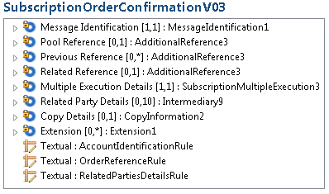
Extension
In Funds Messages
Extension sequence at end of MX.
In hindsight, it would have been better to position ‘the text field’ at the level of the individual order. Philosophy at the time was to make it hard to use, to deter its profligate use.

Slide 5
Extension
A example of usage
Need to carry ‘Order Received Date Time’ in setr.012 & 006. SMPG specified how an extension sequence is used to carry the data until ‘Order Received Date Time’ can be incorporated into the MX in its own field.
<Xtnsn>
<PlcAndNm>MltplExctnDtls/OrdrRcvDtTm</PlcAndNm>
<Txt>2014-02-12</Txt>
</Xtnsn>

Slide 6
Supplementary Data
… things have evolved
The concept has been formalised to extend functionality in a more structured and rigorous way and use XML tags and schemas.
However, it is technically possible to use it in a similar way as before:
<SplmtryData>
<PlcAndNm>MltplExctnDtls/OrdrRcvDtTm</PlcAndNm>
<Envlp>
<auto-generated_for_wildcard xmlns="">2014-02-12</auto- generated_for_wildcard>
</Envlp>
</SplmtryData>

Slide 7
Supplementary Data
Unambiguous reference to the location where
the supplementary data must be inserted in the message instance. In
the case of XML, this is expressed by a valid XPath.
Structure and definitions:
Additional information that cannot be captured in the structured elements and/or any other specific block.
Technical element wrapping the supplementary data.
This component may not be used without the explicit approval of a SEG and submission to the RA of ISO 20022 compliant structure(s) to be used in the Envelope element.
The Rule is ‘tougher’. But funds didn’t obey the rule on Extension1!

Slide 8
Supplementary Data – scenario for intended usage
Fictitious Scenario
Let’s imagine that in some markets all order confirmations must be copied to the regulator and two pieces of data must be provided to the regulator that are not present in the MX. The decision is to use the supplementary mechanism, instead of adding the two new data elements to the ‘base’ message.
A schema (Funds Reporting Data supl.800.001.01) is created to carry this regulatory data. At ‘run-time’, the additional data is specified in the Supplementary Data sequence as an XML message, conforming to supl.800.001.01. The confirmation is sent to the distributor and the regulator.
The regulator may validate the elements of the Supplementary Data sequence against supl.800.001.01. (The distributor can ignore the Supplementary Data sequence.)

Slide 9
Supplementary Data – scenario for intended usage
<SbcptOrdrConfV04>
<MltplExctnDtls>
….
<IndvExctnDtls>
<OrdrRef>Order 1</OrdrRef>
<DealRef>Deal 1</DealRef>
<FinInstrmDtls>
<Id>
<ISIN>GB1234567890</ISIN>
</Id>
</FinInstrmDtls>
……
</IndvExctnDtls>
</MltplExctnDtls>
<SplmtryData>
<Envlp>
<auto-generated_for_wildcard xmlns="">
<Document xmlns="urn:iso:std:iso:20022:tech:xsd:supl.800.001.01“
xmlns:xsi="http://www.w3.org/2001/XMLSchema-instance">
<FundsRprtngData>
<Bnfcry>J Chapman</Bnfcry>
<WthhldngTax>GBP 15</WthhldngTax>
</FundsRprtngData >
</Document>
</auto-generated_for_wildcard>
</Envlp>
</SplmtryData>
</SbcptOrdrConfV04>
Extract of ‘normal’ part of the message
The supplementary data sequence contains another message instance, in this case Funds Reporting Data (supl.800.001.01). (This is a fictitious example!)

Slide 10
Supplementary Data
<Xtnsn>
<PlcAndNm>MltplExctnDtls/OrdrRcvDtTm</PlcAndNm>
<Txt>2014-02-12</Txt>
</Xtnsn>
today
<SplmtryData>
<PlcAndNm>MltplExctnDtls/OrdrRcvDtTm</PlcAndNm>
<Envlp>
<auto-generated_for_wildcard xmlns="">2014-02-12</auto-
generated_for_wildcard>
</Envlp>
</SplmtryData>
tomorrow
Can funds accept replacement of Extension (Extension1) by SupplementaryData (SupplementaryData1)?
Are there any alternatives?
See next slide

Slide 11
Alternatives overview
Are there any alternatives?
No impact on instance,
no impact on schema
Alternative 1:
[i] add SupplementaryData
[ii] keep Extension sequence typed by Extension1.
Would need RMG approval.
Alternative 2:
[i] add SupplementaryData
[ii] keep Extension sequence but typed by message component similar to Extension1 (modification of definitions on the message component)
No impact on instance, impact on schema
Alternative 3:
[i] replace Extension with Supplementary Data
[ii] add a repetitive text sequence to be used to
specify missing fields
impact on instance,
impact on schema

Slide 12
Alternative 2 Details
Alternative 2:
[i] add SupplementaryData
[ii] keep Extension sequence but typed by message component similar to Extension1 (modification of definitions on the message component)
No impact on instance, impact on schema
Extension [0.n] Extension 1 → replaced with Extension N
Extension N
Place And Name
Text
Extension Rule
Definition of this rule is
This component may not be used without the explicit approval of the Registration Authority and without strict usage rules published by the Registration Authority.
We would amend this rule
Impact
Impact on schema because of the change of message component number.
When MyStandards MP is migrated to a new version of the message with this new component, the MP on the Extension sequence is automatically migrated, so there is no impact on MP defined.

Slide 13
Alternative 2 Details
Alternative 2:
[i] add SupplementaryData
[ii] keep Extension sequence but typed by message component similar to Extension1 (modification of definitions on the message component)
No impact on instance, impact on schema
Extension [0.n] Extension 1
Extension 1
Element | Definition
Place And Name | Name qualifying the information provided in the Text field, and place where this information should be inserted.
Text | Text of the extension
Extension Rule | This component may not be used without the explicit approval of the Registration Authority and without strict usage rules published by the Registration Authority. | This definition

Slide 15
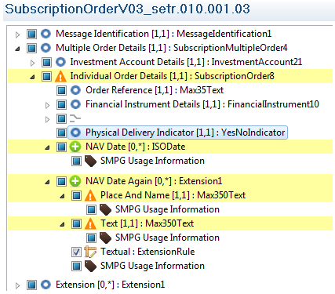
This is how we have been told it should be done
What happens to this date post migration to V04 of the MX.
This is how we have been specifying how to format an Extension
When the MX is migrated to V04 of the standard (also containing an Extension (Extension1) sequence, we will loose the data type for NAVDateAgain and the Extensions
(NMPGs often use Extensions domestically )

