Slide 1
Harmonizing bond standards in Asia
Regional cooperation and market integration under ASEAN+3 Bond Market Forum (ABMF)
SMPG meeting
5 Nov 2012, Osaka, Japan
Shinji Kawai, Sr. Financial Sector Specialist, ADB

Slide 2
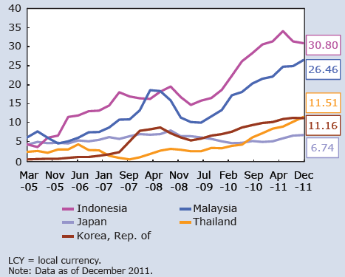
Bond markets in Asia – developments and issues
LCY bonds outstanding of emerging East Asia
Rapid growth in size with more than USD 5 trillion LCY bonds outstanding in 2011
Share of emerging East Asia in world LCY outstanding : 2.1% in 1996 ⇒ 8.0% in 2011
Foreign holding of LCY bonds
Increased foreign investors’ participation since mid 2000s

Slide 3
Bond markets in Asia – developments and issues
Debt Securities Portfolio Outflows in the region (%, 2009)
Regional resource channeling is very low (4.3% in 2009)
Cross border flows have become more volatile
Foreign Portfolio Inflow

Slide 4
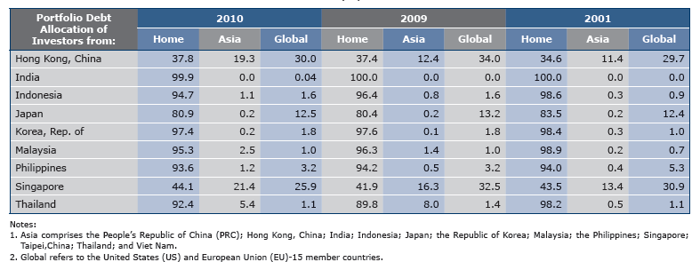
Portfolio Debt Allocation of Asian Investors
Source: Asian Bond Monitor April 2012. ADB/OREI calculated based on data from Asian Bond Online, BIS and IMF.

Slide 5
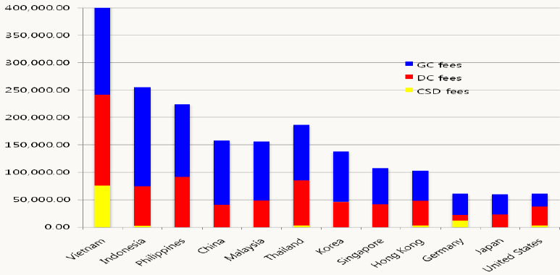
Bond markets in Asia – developments and issues
Transaction costs are significantly higher than other markets
Estimated Custodian Fees (USD per year)
Estimated Custodian Fees (USD per year)
Source: ABMI Group of Expert Report (2010)

Slide 6
Bond markets in Asia – developments and issues
Better functioning markets in future
Developing intra-regional bond markets
Lower transaction costs
Efficient regional resource recycling
More stable capital flows
Various regional initiatives to further develop the markets in the region such as Asian Bond Market Initiative (ABMI) under ASEAN+3
ASEAN+3 Bond Market Forum (ABMF) : To facilitate the development by harmonizing regulations and market practices
Asian bond markets today
Individual market growth
Market inefficiency
Low regional resource channelling
Volatility in cross border flows

Slide 7
What is ASEAN+3?
Regional collective reaction to the Asian Currency Crisis in 1997-98
  Started gathering since 1999
Significant influence to the world economy could be possible
  24% of world GDP
  32% of world population
  More that half of world FX reserves
One of the most active and result- oriented cooperation framework in the region
PRC JAP KOR
ASEAN
BRU CAM
INO LAO
MAL MYA
PHI SIN
THA VIE
AEC
2015

Slide 8
Structure and issues of ASEAN+3
Finance Ministers and Central Bank Governors Meeting
Deputy Ministers and Deputy Governors Meeting
CMIM
Regional safety net
ABMI
Asian Bond Market Initiative
TF 1
(Supply)
TF 2
(Demand)
TF 3
(Regulation)
TF 4
(Infra.)
US$ 240 bn. of self supporting system established
Regional Settlement Intermediary (RSI) under discussion
ASEAN+3 Bond Market Forum (ABMF) organized
Regional credit guarantee facility (CGIF) launched

Slide 9
Establishment of ABMF in 2010
Harmonizing bond market standards and practices has been a long standing issue of ABMI since 2003
  No easy solution and tardy progress despite heavy discussion among government and central bank officials
To foster the discussion, Finance Ministers endorsed the establishment of ASEAN+3 Bond Market Forum in May 2010
  As a common platform for harmonization in the region
  To provide (non-binding) policy recommendations to ASEAN+3 officials and policy authorities

Slide 10
Establishment of ABMF in 2010
Both public institutions and private market players are participating together in ABMF
  Most of the exchanges, depository bodies, and market associations
  Some of capital market regulatory authorities
  Regional and global market participants
Barclays capital, BNP Paribas, Citibank, Clearstream,
Deutsche Bank, HSBC, JP Morgan, Mori Hamada & Matsumoto,
State Street, SWIFT, The Bank of Tokyo Mitsubishi UFJ
  Some of research institutions
  Observers (e.g., ABMI officials)
Since its inauguration meeting in Sep 2010, participating members and observers have been continuously increasing

Slide 11
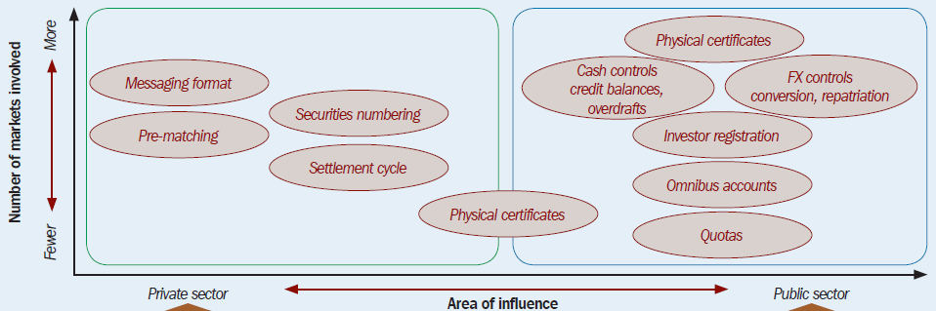
AMBF activities during 2010-2011 (Phase 1)
Sub Forum 1(SF1)
Collecting information on regulations and market practices
Sub Forum 2(SF2)
Identifying cross border bond transaction flows to -> Enhancing regional STP

Slide 12
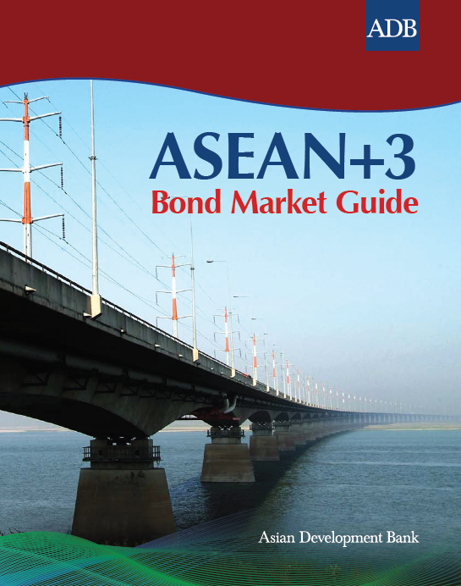
AMBF activities during 2010-2011 (Phase 1)
Produced comprehensive Market Guide in Apr 2012
The first guide endorsed by ASEAN+3 officials
Comprehensive market information with 1,532 pages
Product of the collaborative efforts of ABMF members
Benefit bond markets in the region by enhancing investors’ understanding of the markets
Base material for next ABMF activity (Phase 2)

Slide 13
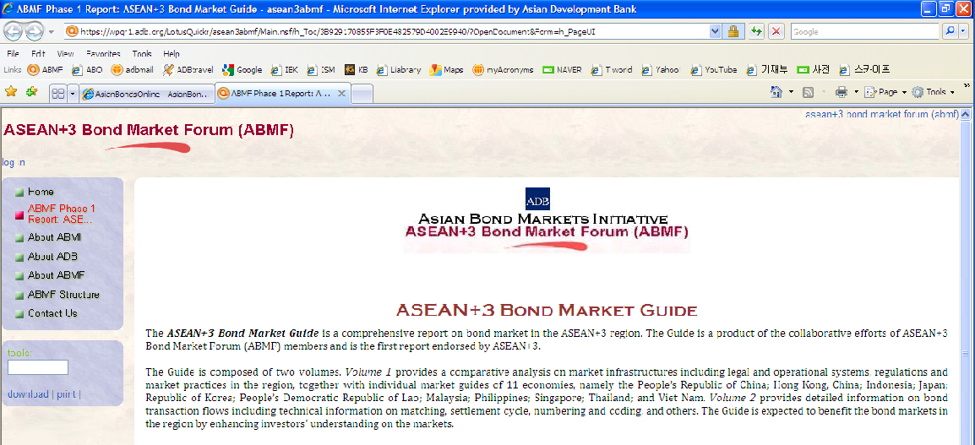
AMBF activities during 2010-2011 (Phase 1)
Available at ABMF Home Page and AsianBondsOnline

Slide 14
AMBF activities during 2012-2013 (Phase 2)
<SF1>
Based on the findings during Phase 1, to develop regionally standardized bond issuance program
  By focusing on professional markets which waive full disclosure requirements
  Develop a program/framework that allows bond issuers in any participating economies to issue bonds in any participating locations with one set of standardized documentation and information disclosure requirements
  AMBIF: Asian Multi-currency Bond Issuance Framework

Slide 15
Market Function principle based approach
(Our Target Market / Market Segment)
Key Factor | Full Disclosure requires Market | (*) Limited Disclosure Market (Our Target) | No Disclosure requires Market
Disclosure | Full Disclosure Registrations (SRS) | Limited Disclosure Exemption | Full Exemption
Investor | General Investors main | Professional Investors | 100% Professional
Market Liquidity | ◎ | ○ Tradable among Professionals | X Non-tradable Possessed until maturity
Selling Restrictions | Nothing | Yes: to Non-professional investors | Yes: to Non-professional investors
Documents | Prospectus | Info. Memo Offering Circular | -
(*) “Limited disclosure” refers to a certain level of disclosure information that can be accepted as a minimum required information by professional investors.

Slide 16
Exempted/Limited Disclosure market
vs. Full disclosure market
Offshore Eurobond market
Domestic market
Public offering market
with general investors
including retail sector
Other Jurisdictions’ markets
Professional market
Exempted market
Limited Disclosure market
with full disclosure requirement
Our Target MKT or
Market Segment
Fully regulated area

Slide 17
Connecting the professional market elements
in the region to one another…
General Investors Market
Including Retail Sector
Professional Market
Pro
Pro
Pro
Pro
Pro
…can create a common limited disclosure market.

Slide 18
We can, thus, create an integrated intra-regional
multi currency professional bond market!
Asian
Intra-Regional
Multi Currency Professional Bond Market
(AMBIF Market)
… will bring benefits for participants and industry

Slide 19
Benefits of AMBIF could be significant
For Issuers
Limited disclosure
Defined documentation
Reduced issuance cost
Time to market
Ability to tap multiple markets, anytime
No FX considerations
For Markets and Investors
Additional LCY issuance
Broadens and deepens market offerings
Regulatory comfort as part of AMBIF process
Investor protection specifically built in
For Industry / Professional
Creation of accessible new market

Slide 20
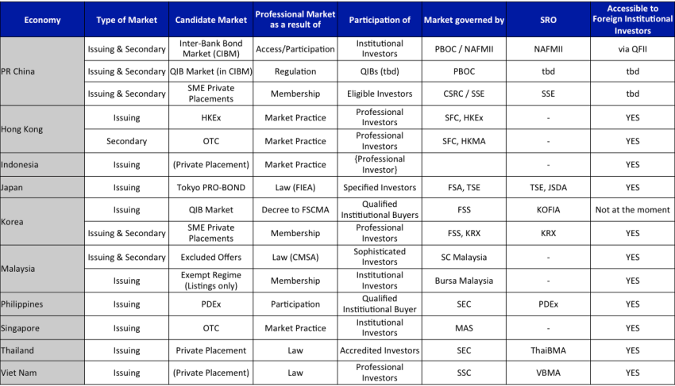
Comparison of Market Features…
(i.e. the study of specific characteristics across a selection of categories)
Sample
Professional Investors
Private Placement
Key Documentation
Treatment of Foreign Investors

Slide 21
AMBF activities during 2012-2013 (Phase 2)
<SF2>
Continue identification of transaction flows, messaging and market practices.
  DVP flows and procedures for corporate bonds
  Interest payment and redemption of government bonds
  Interest payment and redemption of corporate bonds
ISO 20022 Fit-and-gap analysis
Propose a roadmap and policy recommendations to standardize and harmonize transaction flows, and to enhance STP in the region

Slide 22
Vision and work flow of SF2
Enhancing cross border STP in ASEAN+3
Phase 1
Phase 2
After Phase 2
  Start of ABMF
  Identifying DVP flows of gov. bonds
  Take status quo of market infrastructure
  DVP flows of corp. bonds / Interest payment & redemption flows
  Fit & gap analysis
  Policy recommendations and roadmap
  * To be clarified by the members
  E.g., enhancing regional trade & settlement infrastructure
Technical issues
Policy issues

Slide 23
ASEAN+3 Government Bond Market Diagram
MM LA KH BN
VN
TH
SG
PH
MY
KR
JP
ID
HK
CN
Trade
Trade match.
CCP
Settle match.
Bond Settle.
Cash settle.
OTC
OTC
OTC
OTC
PDEx
OTC
OTC
KRX
OTC
OTC
OTC
OTC
Inter-bank
Bond Market
SSE
&
SZSE
HNX
TCH
PTI
PDEx
BMS
ETP
KRX
JASDEC
PSMS
HKMA
CMU
CFETS
SSE
&
SZSE
KRX
JGBCC
SSE
&
SZSE
PDEx
eDvP
VSD
TCH
PTI
MAS
MEPS+ SGS
PDEx
Ross STP
Facility
BNM
RENTAS-SSDS
KSD
JASDEC
PSMS
BI
BI-SSSS
HKMA
CMU
CCDC
CSDCC
PDTC
TSD
PTI
BT
BTr-ROSS
BOJ
BOJ-NET
BIDV
BOT
BAHTNET
MAS
MEPS+ RTGS
BSP
PhilPass
BNM
RENTAS-IFTS
BOK
BOK-Wire+
BOJ
BOJ-NET
BI
BI-RTGS
HKMA
CHATS
PBOC
HVPS CNAPS
Comm.
Banks
NOTE:
Exchange
Exchange related
Direct intersystem connection
Central Bank
Central Bank related
Indirect connection . Trade data (bond settlement instructions) are entered to CSD by agent custodians.
Commercial Bank
* This diagram shows only infrastructures and entities which process major transaction volume in each economy.
Notes:
23

Slide 24
ASEAN+3 Corporate Bond Market Diagram
MM LA KH BN
VN
TH
SG
PH
MY
KR
JP
ID
HK
CN
Trade
Trade match.
CCP
Settle. match.
Bond Settle.
Cash settle.
OTC
OTC
OTC
OTC
PDEx
OTC
OTC
KRX
OTC
OTC
IDX
OTC
OTC
Inter-bank
Bond Market
SSE
&
SZSE
HNX
TCH
PTI
PDEx
BMS
ETP
KRX
JASDEC
PSMS
KPEI
HKMA
CMU
CFETS
SSE
&
SZSE
KRX
SHCH
SSE
&
SZSE
PDEx
eDvP
VSD
TCH
PTI
CDP
PSMS
PDTC
BNM
RENTAS-SSDS
KSD
JASDEC
PSMS
KSEI
C-BEST
HKMA
CMU
SHCH
CCDC
CSDCC
TSD
PTI
CDP
DCSS
JASDEC
Book Entry
Transfer System
BIDV
BOT
BAHTNET
MAS
MEPS+ RTGS
BSP
PhilPass
Commercial
Banks
BNM
RENTAS-IFTS
BOK
BOK-
Wire+
Commercial
Banks
BOJ
BOJ-NET
Commercial
Banks
HKMA
CHATS
PBOC
HVPS CNAPS
Commercial
Banks
NOTE:
Exchange Market
Exchange related
Direct intersystem connection
Central Bank
Central Bank related
Indirect connection . Trade data (bond settlement instructions) are entered to CSD by agent custodians.
Commercial Bank
* This diagram shows only infrastructures and entities which process major transaction volume in each economy.
Notes:
24

Slide 25
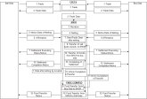
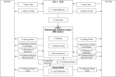
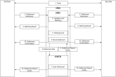
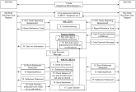
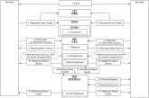
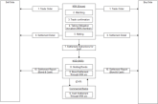
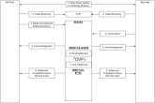
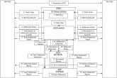
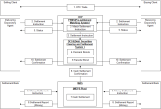
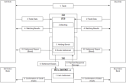
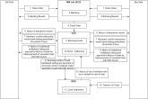
Corporate Bond Transaction Flow for Domestic Trades
CN (OTC)
CN (EX)
HK
ID
KR (OTC)
KR (Ex)
MY
PH
SG
TH
VN

Slide 26
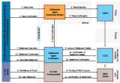
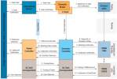
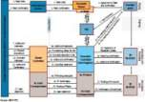
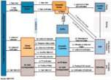
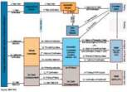
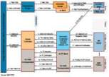
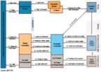
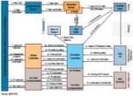
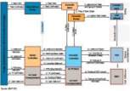
Bond Transaction Flows for Foreign Investors
CN (OTC)
CN (EX)
HK
ID
KR
MY
PH
SG
TH
VN

Slide 27
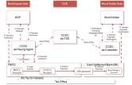
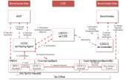
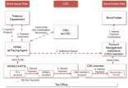
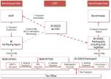
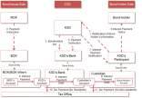
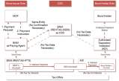
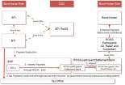
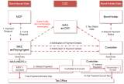
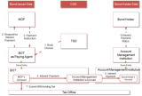
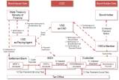
Government Bond Interest Payment Flow in ASEAN+3
CN (OTC)
CN (EX)
HK
ID
KR
MY
PH
SG
TH
VN

Slide 28
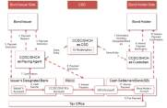
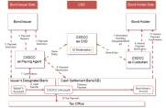
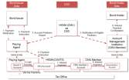
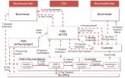
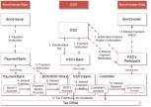
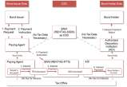
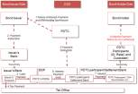
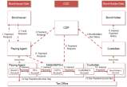

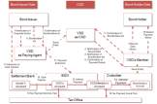
Corporate Bond Interest Payment Flow in ASEAN+3
CN (OTC)
CN (EX)
HK
ID
KR
MY
PH
SG
TH
VN

Slide 29
Fit & Gap Analysis
1. Fit & Gap Analysis of message flows
  Message flows of government bond and corporate bond in each economy are compared with typical DVP flow in ASEAN+3
2. Fit & Gap Analysis of message items
  Fit & Gap Analysis of message items is conducted for settlement instruction (sese.023.001.03) and settlement confirmation (sese.025.001.03). The 10 common elements proposed by SMPG (Securities Market Practice Group) are chosen for the FIT&GAP Analysis of message as a preliminary study of the analysis.

Slide 30
FIT&GAP Analysis and Policy Recommendation
INPUT
FIT&GAP Analysis Processes
OUTPUT
Possible future issues
Identify practices already standardized
Message
Flows
DVP
Flow
DVP
Flow
Standard Flows
FIT&GAP
Analysis
Identify practices need to be kept as it is now
Standard
Messages
Message
Items
Identify practices to be standardized
Recommendations and Roadmap
FIT&GAP analysis of proprietary practices with ISO 20022 is underway to harmonize the bond trade and settlement in ASEAN+3

Slide 31
Possible goal (ISO standards)
ASEAN+3 proprietary practices
Current
having some differences economy by economy.
having some differences from international standards.
Future
to be changed to meet international standards and/or
to be accepted by International standards after conforming in the region
ISO 20022
International standards (in particular ISO20022) are the focal point and hub of local standards

Slide 32
Thank you
http://asean3abmf.adb.org
http://asianbondsonline.adb.org
For further information
Dr. Seung Jae Lee, Advisor: sjlee@adb.org
Mr. Shinji Kawai, Senior Financial Sector Specialist: skawai@adb.org

