Slide 1
Meeting Events with Fees
International Securities - Eurobonds

Slide 2
Proposed Process flow – Scenario 1
Issuer
Paying Agent
Meeting Notification (seev.001.001.xx)
1
2
Meeting Instruction V08 (seev.004.001.08)
1
seev.001.001.09
4
pacs.009.001.10
3
4
seev.004.001.08
9
5
seev.007.001.08
Meeting Vote Execution Confirmation V08 (seev.007.001.08)
5
Intermediary (Proxy)
6
Custodian / CSD
seev.031.001.12
Corporate Action Notification (seev.031.001.xx)
6
7
seev.042.001.11
8
2
seev.001.001.09
seev.031.001.12
7
Corporate Action Instruction Statement Report (seev.042.001.xx)
8
5
seev.007.001.08
seev.036.001.13
10
Financial Institution Credit Transfer V10 (pacs.009.001.10)
9
3
Client
seev.004.001.08
Corporate Action Movement Confirmation V13 (seev.036.001.13)
10
Inbound
Message before meeting
Outbound
Message after meeting

Slide 3
Proposed Process flow – Scenario 2
Issuer
Paying Agent
Meeting Notification (seev.001.001.xx)
1
2
Meeting Instruction V08 (seev.004.001.08)
1
seev.001.001.09
4
pacs.009.001.10
3
4
seev.004.001.08
9
5
seev.007.001.08
Meeting Vote Execution Confirmation V08 (seev.007.001.08)
5
Intermediary (Proxy)
6
Custodian / CSD
seev.031.001.12
Corporate Action Notification (seev.031.001.xx)
6
7
seev.007.001.08
8
2
seev.001.001.09
seev.031.001.12
7
Meeting Vote Execution Confirmation V08 (seev.007.001.08)
8
5
seev.007.001.08
seev.036.001.13
10
Financial Institution Credit Transfer V10 (pacs.009.001.10)
9
3
Client
seev.004.001.08
Corporate Action Movement Confirmation V13 (seev.036.001.13)
10
Inbound
Message before meeting
Outbound
Message after meeting

Slide 4
Proposed Process flow – Scenario 3
Issuer
Paying Agent
Meeting Notification (seev.001.001.xx)
1
2
Meeting Instruction V08 (seev.004.001.08)
1
seev.001.001.09
4
pacs.009.001.10
3
4
seev.004.001.08
9
5
seev.007.001.08
Corporate Action Movement Preliminary Advice V13 (seev.035.001.13) (1)
5
Intermediary (Proxy)
6
Custodian / CSD
seev.031.001.12
Corporate Action Notification (seev.031.001.xx)
6
7
seev.035.001.13
8
2
seev.001.001.09
seev.031.001.12
7
Meeting Vote Execution Confirmation V08 (seev.007.001.08)
8
5
seev.007.001.08
seev.036.001.13
10
Financial Institution Credit Transfer V10 (pacs.009.001.10)
9
3
Client
seev.004.001.08
Corporate Action Movement Confirmation V13 (seev.036.001.13)
10
Inbound
Message before meeting
A CR would be required to modify MT 564 NVR C26 and include the new meeting CAEV, as currently, if Code value is equal to INCP in CorporateActionDetails/AdditionalBusinessProcessIndicator, then EventType/Code value must be equal to CONS (Consent).()
Outbound
Message after meeting

Slide 5
Proposed Process flow
Message Type | Early Incentive Premium | Comments
Meeting Notification (seev.001.001.xx) | Issuer notifies via their agent(s) the market participants and intermediaries
Meeting Instruction V08 (seev.004.001.08) | Instructions submitted by holders via intermediaries (or CSD) are forwarded to issuer agents
Meeting Vote Execution Confirmation V08 (seev.007.001.08) | Issuer Agent confirms receipt/execution of vote instruction for early incentive participation | A copy of vote execution confirmation could be sent Scenario 2)
Corporate Action Notification (seev.031.001.xx) | After early incentive deadline, the intermediary generates a CA notification to custodian/CSD with pay-date equivalent to incentive payment date The eligible balance (ELIG) of these events should be determined based on the voting instructions accepted within the linked general meeting event, according to the terms of the incentive/early incentive payment announced in such event. In particular,: The voting instructions giving right to the incentive premium should be used to determine the eligible balance for the incentive premium event. The voting instructions giving right to the early incentive premium should be to determine the eligible balance for the early incentive premium event. As a consequence, only the account owner entitled to receive premium(s) will receive the CA notification(s). | CA notification with new CA CAEV
1
2
3
4
5
6
7

Slide 6
Proposed Process flow
Message Type | Early Incentive Premium | Comments
Corporate Action Instruction Statement Report (seev.042.001.xx) | After the meeting, the proxy voting intermediary generates a CAST report, where Total Eligible Balance represents the amount instructed for early incentive and participation incentive, while the QINS by account provides the break-down by category; in case of an omnibus account, the aggregation of total instructed qty for early/participation incentive will also be reflected in the ENTL, | Scenario 1 - Enhancement of the report with new CAEV event
Financial Institution Credit Transfer V10 (pacs.009.001.10) | The issuer paying agent transfers the cash to the custodian/CSD corresponding to participation to early incentive | Not sur on message type
Corporate Action Movement Confirmation V13 (seev.036.001.13) | Upon receipt of funds, the custodian/CSD confirms cash credit to the client
8
9
10

Slide 7
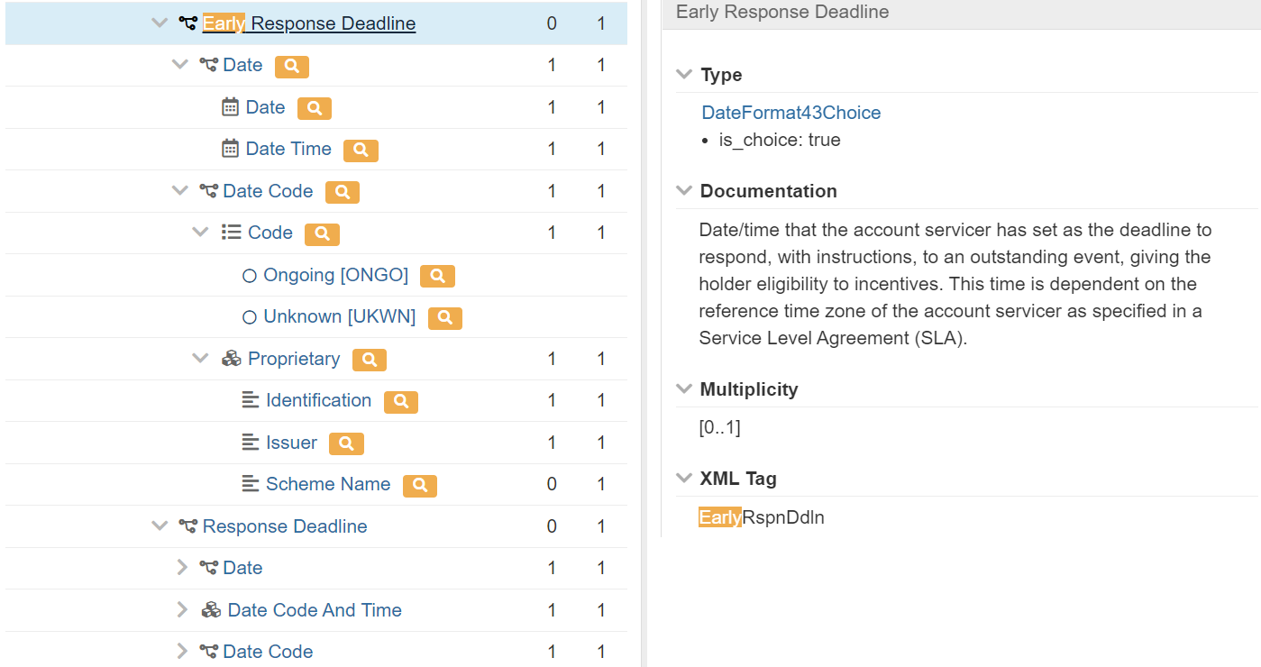
Draft – will be enriched

