Slide 2
APAC RMPG
Establishment
June 2012
Purpose
increase the engagement of the APAC community in global and regional market practice and standards discussion
support the creation of National Market Practice Groups (NMPG) in as many APAC countries as possible and provide assistance to the existing ones.
Organisation
light structure facilitated by SWIFT Standards Singapore (no chair)
one physical meeting / year, conference calls
exchange of information and network building in all APAC countries

Slide 3
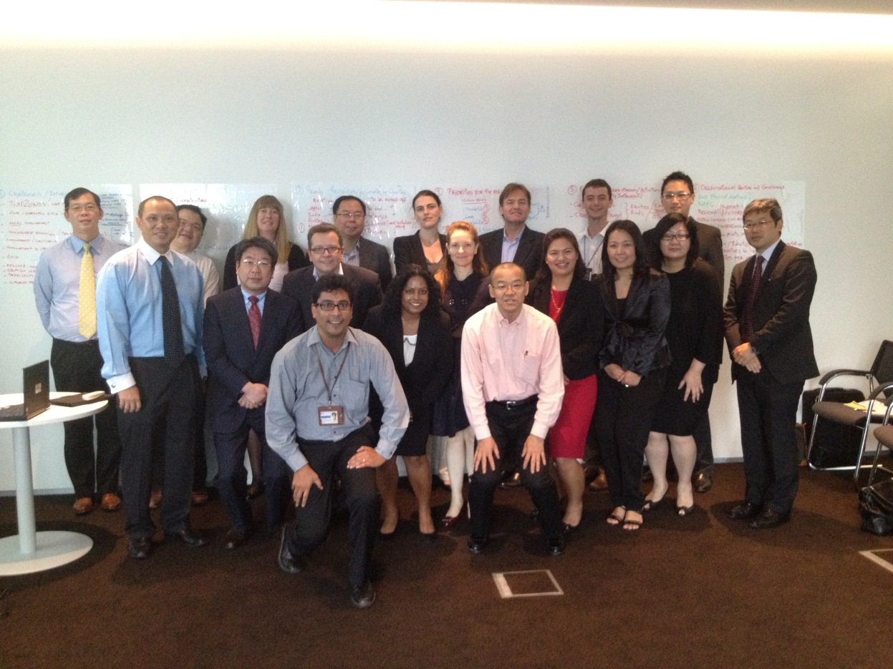
APAC RMPG founding members

Slide 4
APAC RMPG accomplishments
APAC By-laws approved (available in APAC folder on www.smpg.info)
Malaysia: discussion started with custodians and CSD for launch of inclusive NMPG in Q1 2013
Thailand: ETDA, Bangkok bank and TSD helping create awareness for launch of NMPG in Q1 2013
Vietnam: sub-custodian community discussions to start Q4 2012
Hong Kong: discussion ongoing with current group to reshape the structure to be as inclusive as possible

Slide 5
APAC RMPG accomplishments
India: sign-off of 1st set of CA MP templates (in MyStandards). More CA + S&R MP to come. IPO draft discussions
South Korea: plan agreed for work on CA and S&R MP in 2013
First Newsletter published
Seeking support of ABMF and Asian CSD association for creation of NMPG where not present.

Slide 6
Collaboration with ABMF
Two SMPG Steering Committee regional directors as international experts on ABMF SF2
SWIFT Standards as international experts on ABMF SF2
ABMF updates at global SMPG meetings
ABMF support to SMPG for creation of NMPGs in ASEAN + 3
ABMF participation to APAC RMPG and maybe global SMPG in the future
Etc.

