Slide 1
CAJWG & JWGGM SMPG Meeting Christine Strandberg - Frankfurt, 23.04.2013

Slide 2
CAJWG standards
Categories of Corporate Actions
Distributions
Reorganisations
Transaction Management
The scope of application of the proposed market standards includes
All types of the above categories of Corporate Actions
All securities deposited and settled in book entry form with an (I)CSD in Europe
All parties involved
Subject matter of the standards
Information flow throughout the chain
Key dates and their sequence
Operational processing

Slide 3
CAJWG standards, cont.
Distributions are divided into
Cash distributions (e.g. cash dividend, interest payment)
Securities distributions (e.g. stock dividend, bonus issue)
Distributions with options (e.g. optional dividend)
Reorganisations are divided into
Mandatory reorganisations with options (e.g. rights exercise)
Mandatory reorganisations (e.g. stock split, redemption)
Voluntary reorganisations (e.g. tender offer)
Transaction Management is divided into
Market Claims (Distributions)
Transformations (Reorganisations)
Buyer Protection (Elective Corporate Actions)

Slide 4
Sample event timeline

Slide 5
JWGGM standards
The standards cover general meetings-related processes
The aim is harmonised, efficient communication and operational processes so as to ensure that information from the issuer can reach the end investor and vice versa in a timely and cost-efficient manner
The standards are divided into three parts, or processes
Meeting notice: informs the end investor of the issuer’s notice to convene the GM
Record date and entitlement: process to determine and communicate which holdings are entitled to participate in the GM and vote
Notification of participation in the GM: informs the issuer of the end investor or shareholder’s participation (or not) in the GM as well as of his votes, if any

Slide 6
JWGGM standards, cont.
The standards cover the following components, where applicable:
Parties
Content
Messaging format
Language
Timelines
Information flow
Scope of application
In accordance with the SRD, the standards apply for communication with both domestic and foreign end investors
All types of GMs for shares, both bearer and registered, provided they are issued by an issuer having its registered office in a EU member state and whose shares are admitted to trading on a regulated market situated or operated in Europe, and held with an issuer CSD operating in Europe

Slide 7
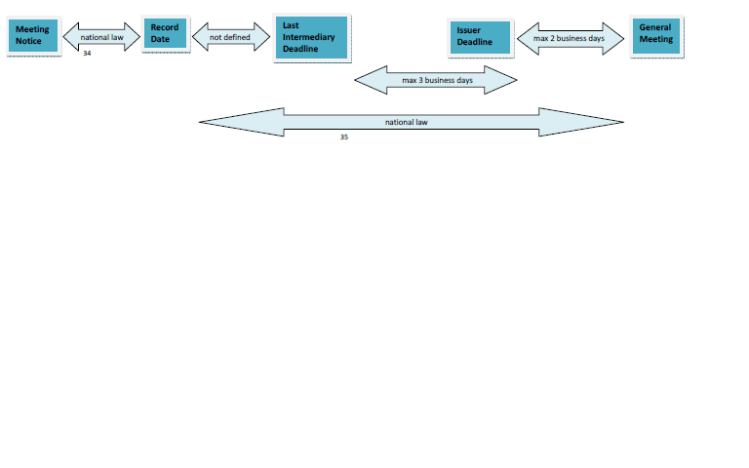
Timeline general meeting

Slide 8
Market implementation
The CAJWG and JWGGM standards are currently under implementation
Most European countries have a Market Implementation Group for this purpose
The implementation process is monitored by the BSG/E-MIG and status is reported to EGMI

Slide 9
Compliance rate autumn 2012
Cash Distr. | Secs. Distr. | Distr. wO | Mand. Reorg. wO | Mand. Reorg. | Volu. Reorg.
70.13% | 66.14% | 50% | 58.33% | 71.06% | 59.37%
Market Claims | Transformations | Buyer Protection
25.86% | 15.32% | 1.77%

Slide 10
QUESTIONS

