Slide 1

Corporate Action Working Group
Meeting will start at 15:15

Slide 2
Agenda
15:00 Registration
15:15 Welcome
Background for the group, proposed framework, relation with existing APAC RMPG, SMPG and NMPGs
Market Data perspective
Agreement on proposed structure and high level scope
15:45 Update on Global CA Activities
16:00 Break
16:15 ASWG work review, what can be reused
16:45 Update on CA Standards and/or Market Practice work in each APAC Country
17:15 Next action and closing.
17:30 Drinks

Slide 3
Agenda
15:00 Registration
15:15 Welcome
Background for the group, proposed framework, relation with existing APAC RMPG, SMPG and NMPGs
Market Data perspective
Agreement on proposed structure and high level scope
15:45 Update on Global CA Activities
16:00 Break
16:15 ASWG work review, what can be reused
16:45 Update on CA Standards and/or Market Practice work in each APAC Country
17:15 Next action and closing.
17:30 Drinks

Slide 4
Background
Feedback from custodians, MDP, brokers on challenges of CA in APAC
ASWG initial work
Increase of ISO CA projects in APAC
Need for a community work on CA related issues in APAC
  To share CA related standards and MP information
  Discuss and solve issues for market with no NMPG CA WG
  Support CA ISO implementation in APAC markets

Slide 5
Market Data Provider perspective

Slide 6
Through the eyes of market data vendors…
Madalene Soon – APAC Reference Data Business Manager
25 February 2013

Slide 7


The role of market data vendors
Content
Format
Delivery
Customer Service

Slide 8






Asia Pacific CA landscape
Sophistication
  Developed vs emerging markets
Readiness
  Electronic vs manual
Timeliness
  Once a day vs real-time
Language
  English vs native
Complexity
  Standards vs local market practices

Slide 9



Why we initiated APAC CA WG?
Build an active regional Community
Let’s uncover local Market Practices
Bring on Standards

Slide 10
Market Data Provider User Group (MDPUG)
The Market Data Provider User Group was set up in 2004 to review the way ISO 15022 corporate action data should be formatted by Securities Market Data Providers and agree standardised usage for all Data Providers.
Who are they?
  Bloomberg
  Fidelity ActionsXchange
  Interactive Data Corporation
  London Stock Exchange (LSE)
  SIX Financial Information
  Thomson Reuters
Purpose
  To establish principles and rules for the use of MT564 & MT568 messages sent by market data providers, aligned to SMPG’s Global Document on Corporate Actions.

Slide 11
Thank you slide

Slide 12
Relation with existing groups
Sub-group of APAC RMPG
Should not duplicate work of global SMPG CA WG or global MDPUG
Should not do the work of NMPG CA WG in APAC
Should support them… (see proposed structure and scope)
But first, to be on the same page

Slide 13

SMPG
Securities Market Practice Group established 15 years ago
Facilitate global harmonisation of market practices
    implementation of ISO messaging in the securities space
Bring together representatives of national market practice groups
    approx. 40 countries, plus ICSDs (Clearstream and Euroclear)
    two physical meetings plus conference calls
    delegates represent their market, not their own institution
Identify commonalities and differences among national practices
Identify opportunities for further harmonisation

Slide 14
SMPG organisation
GLOBAL STEERING COMMITTEE
Trade/
Post Trade
Settlement &
Reconciliation
Corporate
Actions
Investment
Funds
(dormant)
S&R
CA
IF
S&R
CA
IF
S&R
CA
IF
NATIONAL MARKET PRACTICE GROUPS
Settlement & Reconciliation/Corporate Actions
ISO 15022/ISO 20022
Multi-asset class
Process-specific
Investment funds
ISO 20022 only
Funds only
Cross-functional

Slide 15
NMPG role
Open to all securities market participants
IMIs, broker / dealers, custodian banks, central securities depositories, regulators…
Discuss and agree on local harmonised market practices (in line with global practices)
Comment on or propose SMPG global market practice working documents
Send representation to the 2 global SMPG meetings

Slide 16
APAC RMPG
Establishment
    June 2012
Purpose
    increase the engagement of the APAC community in global and regional market practice and standards discussion
    support the creation of National Market Practice Groups (NMPG) in as many APAC countries as possible and provide assistance to the existing ones.
Organisation
    light structure facilitated by SWIFT Standards Singapore (no chair)
    one physical meeting / year, conference calls
    exchange of information and network building in all APAC countries

Slide 17
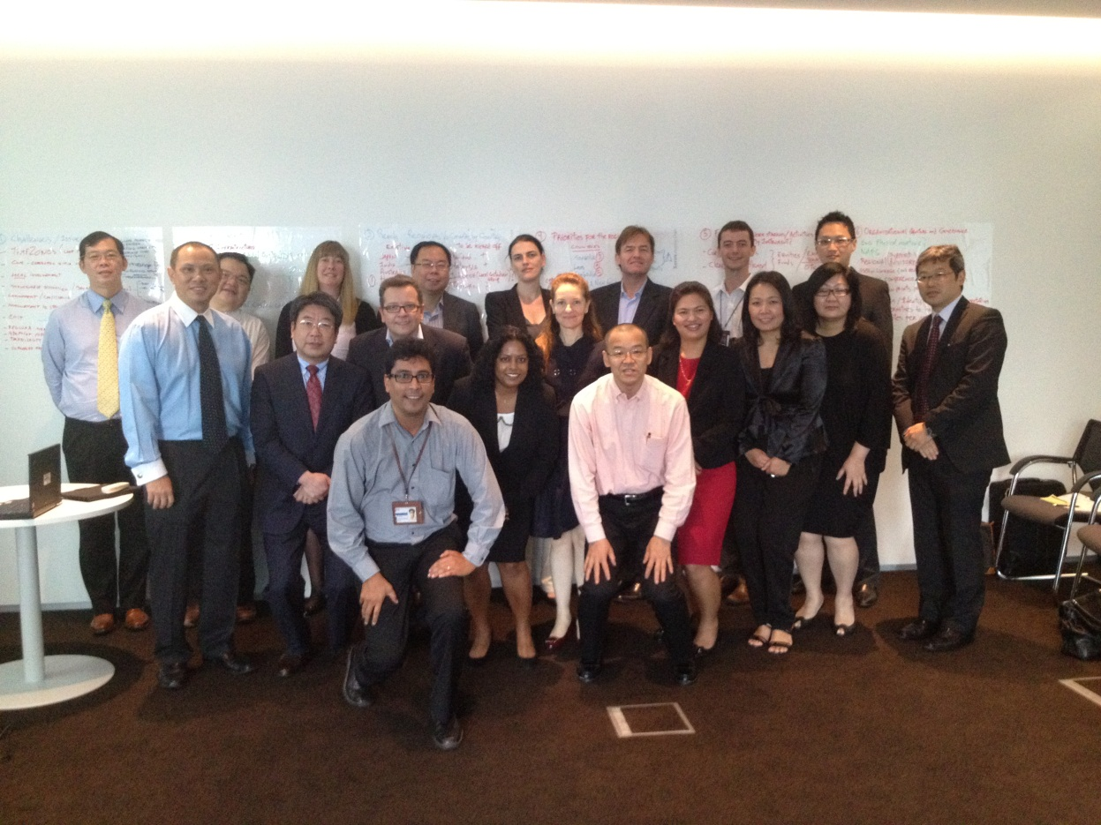
APAC RMPG founding members

Slide 18
APAC RMPG and ABMF
Two SMPG Steering Committee regional directors as international experts on ABMF SF2
SWIFT Standards as international experts on ABMF SF2
ABMF updates at global SMPG meetings
ABMF support to SMPG for creation of NMPGs in ASEAN + 3
ABMF participation to APAC RMPG and maybe global SMPG in the future
Etc.

Slide 19
APAC CA WG proposed scope
to share information about CA issues in the APAC region and mutually look at ways to solve them
to promote ISO standards towards exchanges, CSD and other local parties looking at changing/STPing their CA processes
to discuss and establish informal CA market practices for APAC countries where there is no NMPG CA Working group (waiting for those countries to have a NMPG CA WG to endorse the work done)

Slide 20
APAC CA WG proposed structure
Inclusive working group
CA Experts from exchanges/CSD, custodians, market data providers, brokers, investment managers, etc.
??? CA Software providers ???
No chairs
Facilitation by SWIFT Standards
Bi-monthly WebEx/conference call
One physical meeting per year
Minutes, documents posted on www.smpg.info in APAC RMPG folder

Slide 21
Proposed structure and scope.
Any comments on high level structure and scope?

Slide 22
Agenda
15:00 Registration
15:15 Welcome
Background for the group, proposed framework, relation with existing APAC RMPG, SMPG and NMPGs
Market Data perspective
Agreement on proposed structure and high level scope
15:45 Update on Global CA Activities
16:00 Break
16:15 ASWG work review, what can be reused
16:45 Update on CA Standards and/or Market Practice work in each APAC Country
17:15 Next action and closing.
17:30 Drinks

Slide 23
Global SMPG CAWG in figures
27 member countries (NMPGs) from 3 regions (EMEA, Americas, Japan/Asia)
2 industry groups :
  ICSDs, MDPUG – Market Data Provider User Group)
Monthly conference calls
2 physical meetings / year
19 active countries contributing to MPs creation
17 local MP documents published on web sites
WG active since 2000
About 270 open items discussed/solved since 2006

Slide 24
Global SMPG CAWG achievements
Global MPs documents cover:
    60+ corporate action events & 5 ISO 15022 MT messages
    All CA business processes / Events flows
    Detailed MPs on:
    Messages contents (MT 56x) and fields usage
    Particular Events (e.g. Rights issues)
    Special processes (Preliminary Advice, Market Claims, Proxy Voting basics)
"Event Interpretation Grid +" Table
    Recommended main options and data fields provided for 132 types of events (as SMPG Global MPs) and also for 23 countries (as local MPs)
Additional Events Interpretation tables for:
    Complex events, Redemption events and Return of Capital events
CA Templates document: 67 events message samples fully illustrated

Slide 25
Global SMPG CAWG achievements
COAF (Official CA Events reference) Usage Guidelines and Registration
Yearly CRs submission to ISO15022 maintenance
Involved in ISO20022 CA Reverse Engineering effort

Slide 26
Global SMPG CAWG on going and future developments
3 new CA market practices subgroups on:
    Tax: clarify tax rates usages and related issues)
    ISO 20022 CA: make the CA MPs ISO15022 syntax-independent and covers specificities of ISO20022 messages
    Proxy Voting: covers ISO 20022 proxy voting messages
Posting CA MPs on MyStandards Web-based collaborative platform
Capture Investment Funds requirements for CA (in collaboration with the SMPG IF WG).

Slide 27
Global SMPG CAWG
Any questions, feedback?

Slide 28
Agenda
15:00 Registration
15:15 Welcome
Background for the group, proposed framework, relation with existing APAC RMPG, SMPG and NMPGs
Market Data perspective
Agreement on proposed structure and high level scope
15:45 Update on Global CA Activities
16:00 Break
16:15 ASWG work review, what can be reused
16:45 Update on CA Standards and/or Market Practice work in each APAC Country
17:15 Next action and closing.
17:30 Drinks

Slide 29
Agenda
15:00 Registration
15:15 Welcome
Background for the group, proposed framework, relation with existing APAC RMPG, SMPG and NMPGs
Market Data perspective
Agreement on proposed structure and high level scope
15:45 Update on Global CA Activities
16:00 Break
16:15 ASWG work review, what can be reused
16:45 Update on CA Standards and/or Market Practice work in each APAC Country
17:15 Next action and closing.
17:30 Drinks

Slide 30
Asset Servicing Working Group
3 years ago
SWIFT group
Survey on CA issues
Form “Action Groups”
  Appoint a “lead”
  Agree the “contributors”
  Meet once per month (phone or in person)
  SWIFT can assist with arranging conference bridges, Standards assistance, meeting facilities, asset servicing experts…)
  Agreed timelines and output
  Align with SMPG groups

Slide 31
ASWG 8 original survey questions
Standardise and automate the announcement process
Engage with tax authorities
Increase compliance with Corporate Action Market Practices
Work with infrastructures to move from proprietary to ISO standards
Support adoption of the Corporate Actions Unique identifier
Develop easy access to SWIFT for smaller clients
Improve transparency and efficiency of Shareholders Meeting services
Support implementation of ISO20022 and coexistence with ISO15022

Slide 32
ASWG Priorities at the time
Standardising the announcement process
Engage with Tax Authorities
Increase compliance with Market Practice
Working with Infrastructures
Improve transparency and efficiency of Shareholder meeting service
The other survey items were deemed to be of lesser
priority and to be addressed in a second wave.
Are these priorities still the same?

Slide 33
Update on CA Standards and/or Market Practice work
Any CA ISO 15022/20022 projects?
If so, what SMI?
If so, when?
NMPG?
NMPG CA WG?
If so, EIG column?
If so, CA MP document published?
Known issues

Slide 34
Australia

Slide 35
Singapore

Slide 36
Hong Kong

Slide 37
India

Slide 38
China

Slide 39
Japan

Slide 40
Korea

Slide 41
Indonesia

Slide 42
Malaysia

Slide 43
Thailand

Slide 44
Vietnam

Slide 45
Philipines

Slide 46
BLCM

Slide 47
Other

Slide 48
Agenda
15:00 Registration
15:15 Welcome
Background for the group, proposed framework, relation with existing APAC RMPG, SMPG and NMPGs
Market Data perspective
Agreement on proposed structure and high level scope
15:45 Update on Global CA Activities
16:00 Break
16:15 Update on CA Standards and/or Market Practice work in each APAC Country
16:45 ASWG work review, what can be reused
17:15 Next action and closing.
17:30 Drinks

Slide 49
Next actions
Minutes from the meeting
Survey on priorities?
Next call, when? Before the CA SMPG meeting 23-25 April?
Anything else?

Slide 50
Closing

Slide 51
Agenda
15:00 Registration
15:15 Welcome
Background for the group, proposed framework, relation with existing APAC RMPG, SMPG and NMPGs
Market Data perspective
Agreement on proposed structure and high level scope
15:45 Update on Global CA Activities
16:00 Break
16:15 Update on CA Standards and/or Market Practice work in each APAC Country
16:45 ASWG work review, what can be reused
17:15 Next action and closing.
17:30 Drinks

