Slide 2
APAC RMPG
Establishment
June 2012
Purpose
increase the engagement of the APAC community in global and regional market practice and standards discussion
support the creation of National Market Practice Groups (NMPG) in as many APAC countries as possible and provide assistance to the existing ones.
Organisation
light structure facilitated by SWIFT Standards Singapore (no chair)
one physical meeting / year, conference calls
exchange of information and network building in all APAC countries

Slide 3
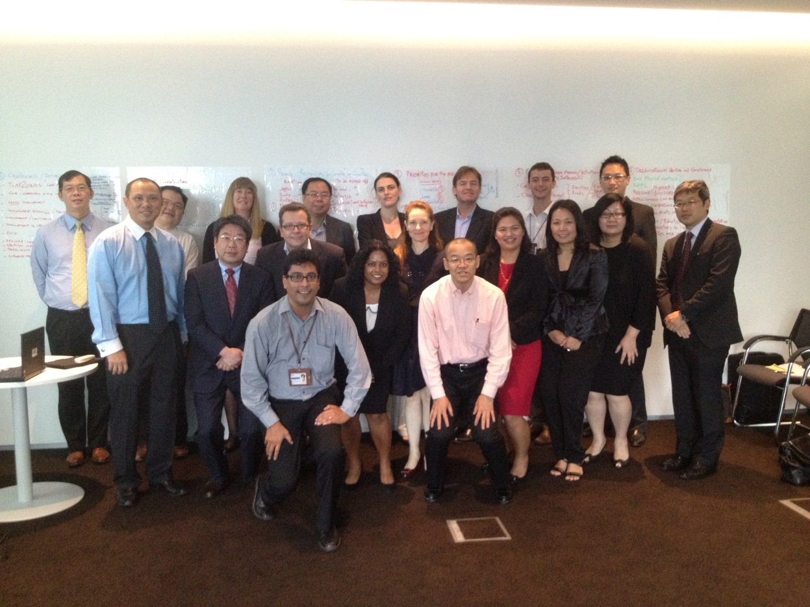
APAC RMPG founding members

Slide 4
APAC RMPG accomplishments
Bi-monthly calls
APAC By-laws approved (available in APAC folder on www.smpg.info)
Two global Market Practices (IPO, DR) from APAC
2 Newsletters published, third to come by end of June.
ABMF support for NMPGs
APAC CA Working Group launched

Slide 5
APAC RMPG accomplishments
NMPGs:
Korea: CA WG kicked off with aim to publish MP in 2013.
Singapore is reorganizing itself with CA and S&R MP plans
Malaysia: Kick-off meeting in May 2013
Thailand: Aiming at kick-off meeting in Q3 2013
Vietnam: Aiming at kick-off meeting by end 2013.
Hong Kong: discussion ongoing with current group to reshape the structure to be as inclusive as possible.
Indonesia: discussion with custodians and CSD to restart by end of the year.
India: sign-off of 1st set of CA MP templates (in MyStandards). More CA + S&R MP to come.

Slide 6
APAC RMPG what is next
Increased involvement in global SMPG and standards discussions?
Support of existing NMPGs and creation of new ones?
?
?
?

