Slide 1
ISO 20022 adoption

Slide 2
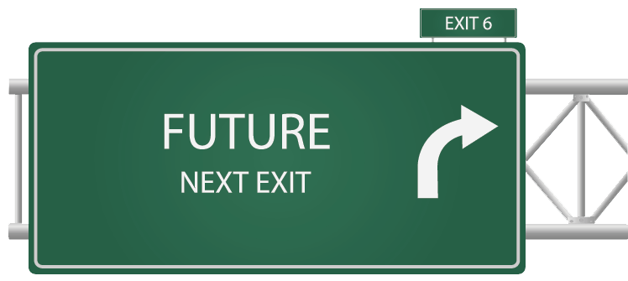
ISO 20022: Connecting the dots
ISO 20022 Who ?
ISO 20022 When ?
ISO 20022 How ?
ISO 20022 Why ?

Slide 3
ISO 20022: Where is it used?

Slide 4
ISO 20022 Adoption – Payments MI & initiatives From discussion to implementation
CPA, CA
Live
DK
CPA, CA
SEPA,EU
Live
CH
Zengin, JP
FED, US
T2, EU
CIPS?, CN
CNAPSII, CN
BOJNet, JP
CO
TH
ASEAN Payment?
IN
PE
BN?
PG
BR
SG
Live
SADC
AU
IPFA
IPFA
Live
Low-value
High-value
NZ
Live
Planned

Slide 5
ISO 20022 Adoption – Securities MI & Treasury MI – From discussion to implementation
Live
T2S, EU
CSD, EE
Live
CSD, PL
Live
Euroclear
CSD, LT
CN
JASDEC, JP [Post-trade]
DTCC, US
CSD, LI
Clearstream
JASDEC & TSE, JP [Corp.Act]
Live
BN?
Live
ANBIMA, BR
SGX, SG
ASX, AU
CLS
BR, CSD
Securities MI
Treasury MI

Slide 6
ISO 20022 Adoption – Funds (live traffic Jan-Oct 2012)
SE
NO
FI
GB
IE
NL
DE
EE
BE
LU
CH
US
ES
FR
KR
GR
IT
HK
BM
TW
SG
AU

Slide 7
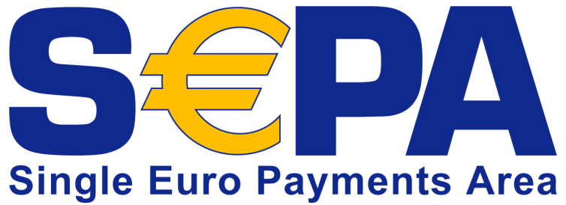
ISO 20022 in the corporate-to-bank space
More than 60 banks receiving payment initiation messages (over SWIFT)
Around 70 members (corporates and banks) defining common global implementation guidelines

Slide 8
Who (and what) is driving ISO 20022 adoption?
New initiatives
Market infrastructures
Global harmonisation & regulation (eg SEPA in Europe)
Automation in specific markets (eg the ‘funds’ market)
New players
Corporates, fund managers
New technology
XML, SOA, web services
From early adopters to ‘followers’
Notes:
Large infrastructure projects (some current users, some planning adoption and some considering adoption)
T2 (live 2007)
SEPA (live Jan 2008)
IPF (Int’l Payments Framework)
Fed/TCH (compatible)
HVPS (G10)
T2S (4CB) and CCBM2 (NBB and DNB)
Euroclear (single platform)
JASDEC / Zengin
DTCC
Regulation and self-regulation
Giovannini barrier 1
Code of conduct (CCPs and post-trade)
LCH Clearnet
Regional drivers
Asia (China, Japan)
BRIC+ (Brazil, Russia)
Switzerland
Germany
South Africa
Customer-driven initiatives
Custodian and Investment Manager CUG in US
Corporates
Microsoft, etc.
Implementation and usage guidelines
Funds (EU and UK communities)
Other standardisers
Investment roadmap (FIX, FpML, ISITC)
XBRL

Slide 9
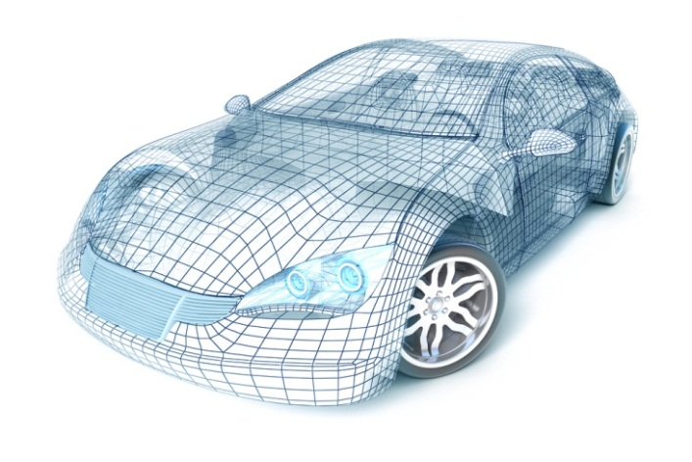
When to adopt ISO 20022?
Drivers:
Harmonization (driven by regulation or innovation)
Renewal of legacy systems
Further automation required
Creation of new services
Interoperability with other systems/players
Notes:
Chinese landscape

Slide 10
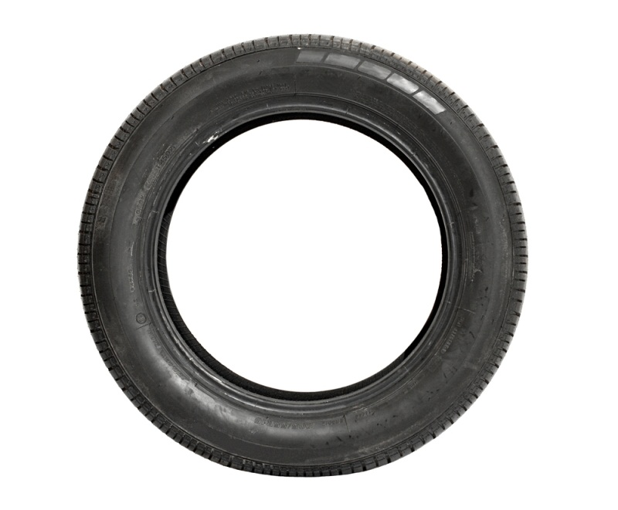
Why adopt ISO 20022
An international and neutral recipe to build a common financial language
Meaning of business processes and information > dictionary
Set of messages to execute end-to-end transactions > repository
Right syntax: XML > universally used, tools available to facilitate implementation
Collaboration with external parties
Internal integration
Standards inter-operability
Notes:
Useful whenever you need common definitions for business concepts:
Externally
Collaborating with a new business partner
On-boarding a new customer
Internally
SOA re-engineering (collaboration across silos)
Internal system integration
Enterprise architecture
Standards interoperability
Aligning on the meaning of elements in different standards

Slide 11
Why adopt ISO 20022 – a global standard to meet local needs
ISO 20022 allows for more flexibility than most proprietary old protocols to cater for local/specific needs
Implementation guidelines: formal way to express market practice
Extensions
Right tools and services available to manage flexibility
ISO 20022
Older protocols

Slide 12
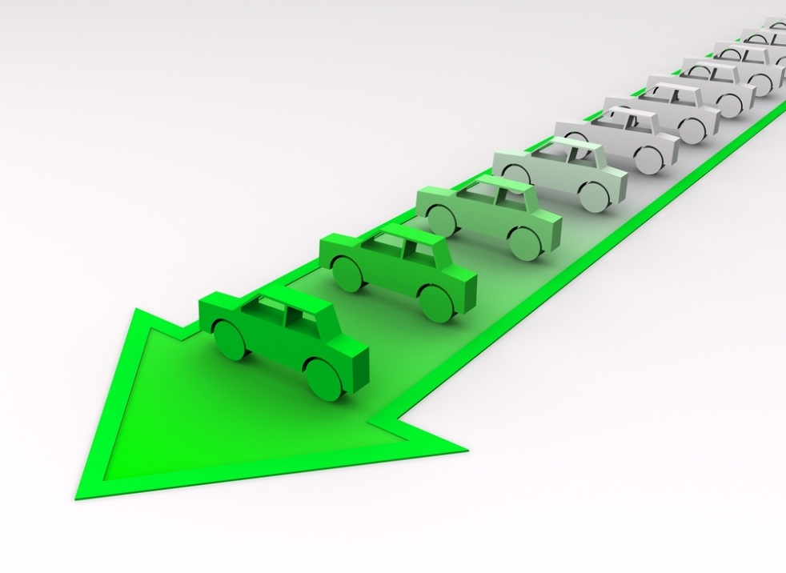
How to adopt ISO 20022 Managing diverging local implementations
Is a risk – but still better - Coordination through working group defining HVP implementation guidelines
Best practice sharing
Tools allow to harmonize MyStandards
Mitigate risks
A risk that can be mitigated by a coordinated approach:
Collaboration and best practice sharing in working groups (eg HVP implementation guidelines, NMPGs, etc)
Services to help communities migrate and implement (roadmap/creation of guidelines/mapping/etc)
Tools (MyStandards) to facilitate sharing and harmonization

Slide 13
Questions?
www.iso20022.org
www.swift.com/mystandards
@standardsforum
#ISO20022
ISO20022 – A Financial Messaging Standard
alexandre.kech@swift.com
mireia.guisado-parra@swift.com

